Slide 1
KPI:s in &frankly

Slide 2
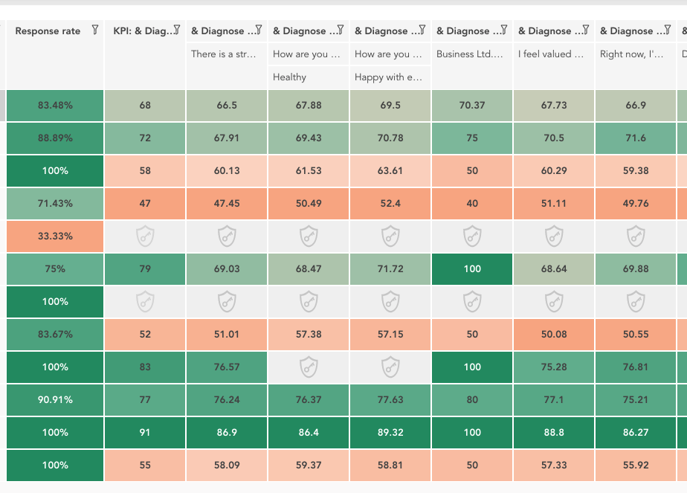
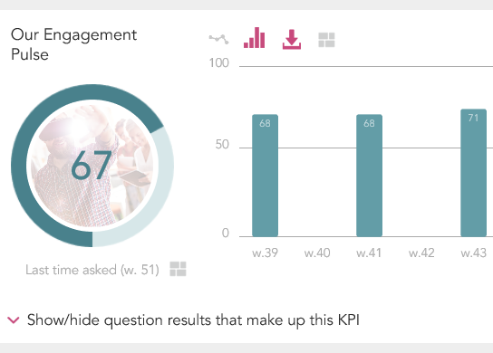
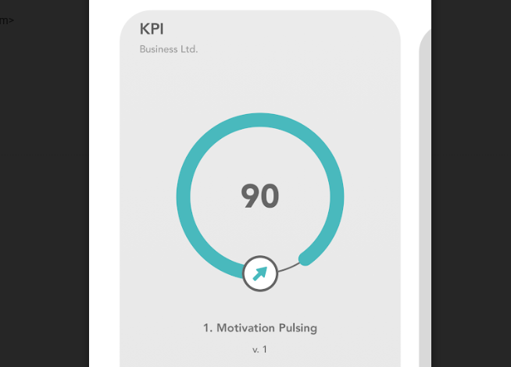
Use an index to follow a set of questions over time
An index is a group of questions put together so that the results of the questions can be followed over time or compared as one score. In &frankly you can use standard packages with a pre-programmed index or create your own index.
The index is reported in three main views.
Overview in the Heatmap
Team view over time in portal
Team view in app
The Heatmap is mainly used by administrators or managers with subgroups to compare.
The KPI view is for a team to follow development over time.
This view is for a team to see this week’s index in an easy way.

Slide 3
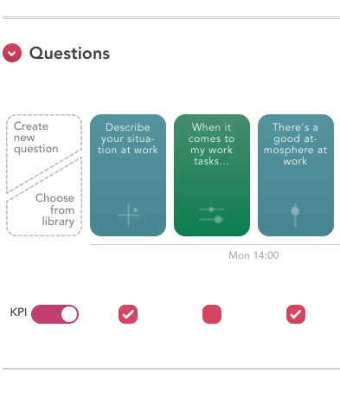
Creating an index in &frankly
Step by step
Create or open a pulse in the section ”Pulse library”
Switch on the KPI circle to activate the Index function
Any question with a red box below the template can be added to your index. (Other questions are excluded since they can't be converted into a numerical value)
Select questions by ticking the red box
Done!

Slide 4
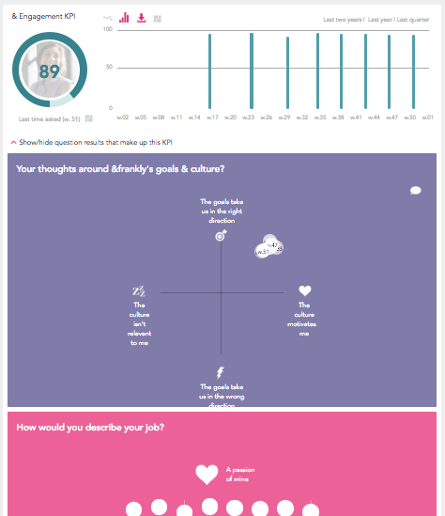
The index value
Understanding the numbers
The KPI is reported on a scale from 0 to 100
The KPI value is the average value for all questions included
Each question in the index have the same weight, e.g. if you have five questions in an index, each question weighs 1/5
The score for each question is calculated according to the question template. Please, see the slides below for further explanation on each template

Slide 5

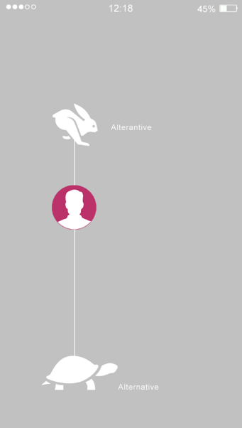
Templates: Growing and Dilemma
Average value on a scale from 0-100 is entered into the index.

Slide 6
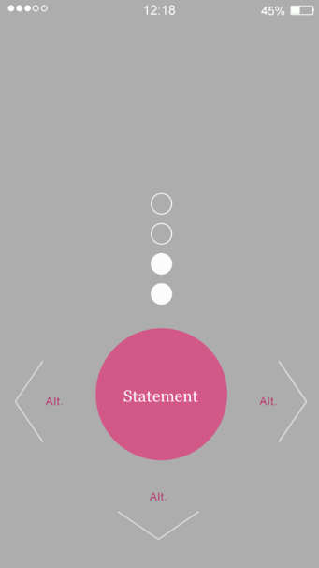
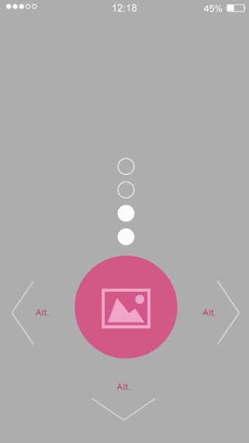
Template: Binary and Binary picture
Average value on a scale from 0-100 is entered into the index.
INDEX = #YES / (#YES + #NO)

Slide 7

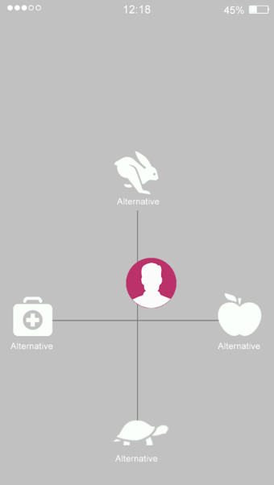
Templates: Super binary and Map
Super binary: Share of "thumbs up" is counted into the index
Map: Average value on a scale from 0-100 is entered into the index. X-axis and Y-axis combined or only one axis may be entered in the index.

Slide 8
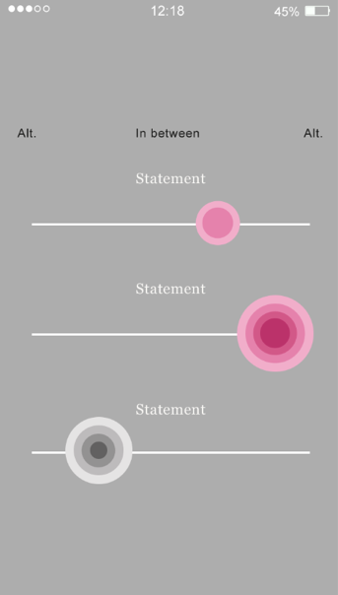
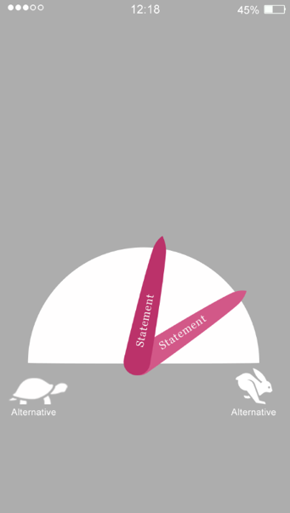
Template: Slider and Meter
Average value on a scale from 0-100 is entered into the index. Parts of the answers are calculated as one score before enterd into the index.

Slide 9
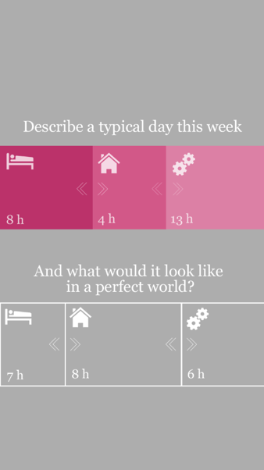
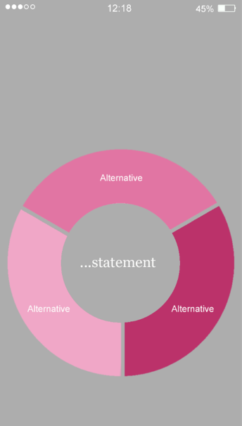
Template: Work life balance and Circle choice
Work life balance: The difference between ideal and a typical working week is mirrored in the index.
Circle choice: Every answer has a defeined value
(Share of reposndents * alternative A + Share of respondents * alternative B + Share of respondents * alternative C + ...) / Total # respondents
.

